Slide 1
Learning English in a Summer School Camp
Zainitdinova Karina
8th form

Slide 2
Aim of our work:
popularization of the English language

Slide 3
Objectives:
- to consider English Summer Camps as a way of popularization English among the younger generation;
- to represent the methodical literature for teaching English in a Summer School Camp.

Slide 4
Object: children from 8 to 14 years old
Subject: English language

Slide 5
Topicality:
English is an integral part of our life today, the study of foreign languages is no longer a luxury, but a simple necessity. The ability to speak in English is the residency card of business and successful people.
There are many ways of teaching English. One of these ways is Summer School Camps as it is important to study English without interruption.
I think that Summer School Camps can help children to improve their English language skills, meet new friends and just have fun.

Slide 7
Motto: «Learn, Laugh, Live!»

Slide 8
Duration of the day: 9.00-14.00
Duration of studies: during the summer

Slide 9
Varieties of activities for youth
1. General English – 15 lessons per week. The course will help improve English language skills by focusing on the key areas: speaking, listening, reading and writing

Slide 10
2. A wide and varied sports and entertainment programme and the use of all sporting and academic facilities

Slide 11
3. Excursions and trips

Slide 12
4. On-line communication with peers from English-speaking countries

Slide 13
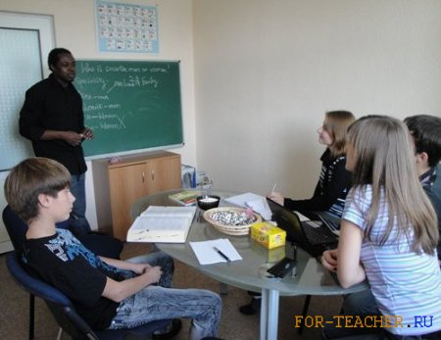
5. Meeting with native speakers

Slide 14
6. Studying English with programmes using the Internet, for example: 1. Duolingo 2. Lingua Leo 3. BBC Learning English

Slide 15
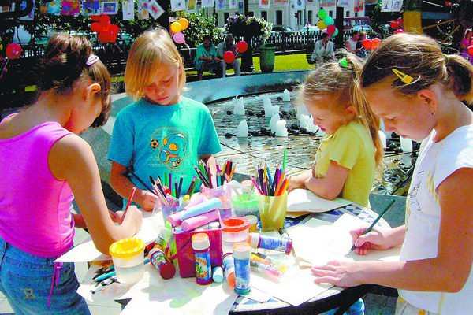
7. Сompetitions, quizzes, olympiads, performances and other creative events

Slide 16
Benefits of an English School Camp
English School Camps offer children to experience new things, gain a sense of independence, have fun and make new friends while participating in exciting activities and mastering the English language. It help develop personal skills too.
At English School Camps children build confidence and self-esteem by learning and developing new skills, communicating and team working.

